Slide 1
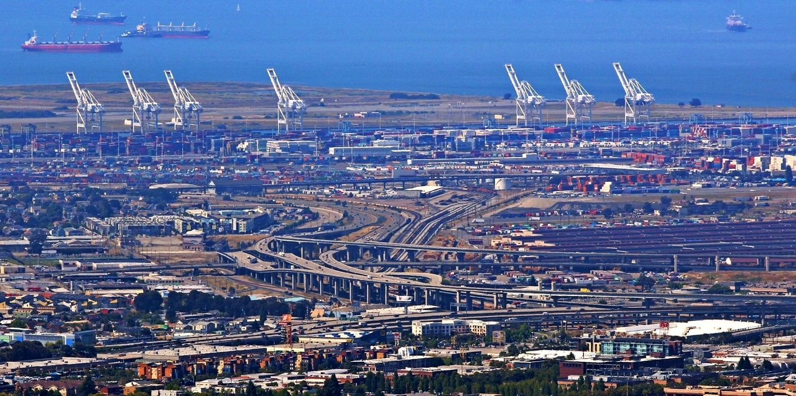
What is a model? What is a simulation?
Dr. Greg Erhardt
greg.erhardt@uky.edu CE599-002

Slide 2
Today’s Topics
What is a model?
Types of models
Agent based models
Materials drawn from:
Michael Batty: What Are Models?
http://www.spatialcomplexity.info/files/2012/01/MRes-Lecture-1.pdf
Malleson & Happenstall: Social Simulation and Agent-Based Modelling
http://www.geog.leeds.ac.uk/courses/level3/geog3150/lectures/lecture3/
Erhardt: Advancing Knowledge in a Generalizable and Testable Manner
Kahani Kahsmir
https://www.slideshare.net/jannap/simulation-andmodeling

Slide 3
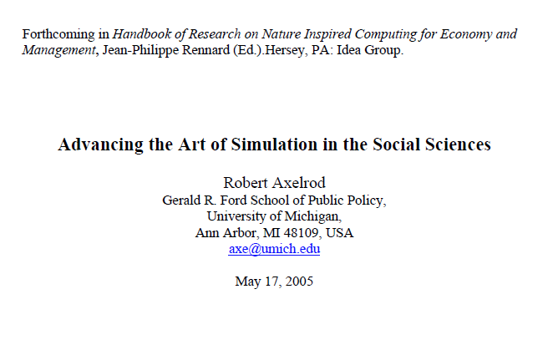
Reading

Slide 4
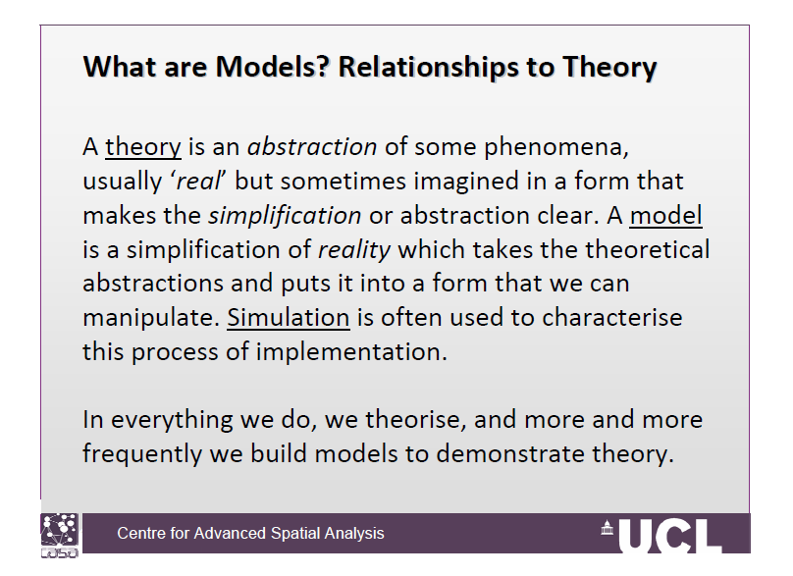

Slide 5
Some examples of models
Model cars
Fashion models
Role models
Maps
Blueprints
Flow charts
Equations
Computer simulations
Video games

Slide 6
Models and theory
A model is one way of formally articulating a theory.
We can do this through:
Writing
Math
Computer programs

Slide 7
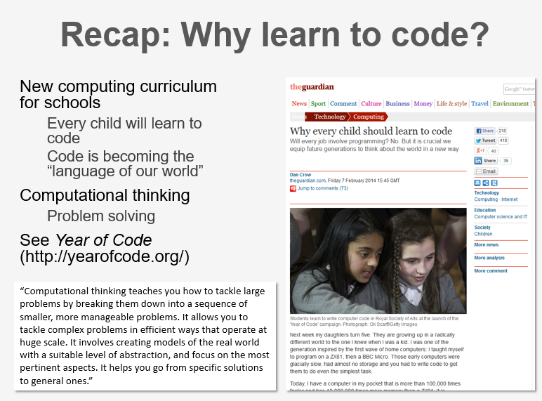
Malleson & Happenstall

Slide 8
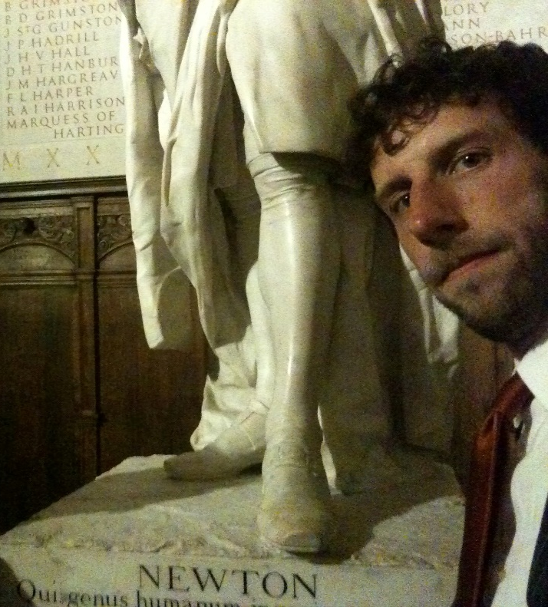
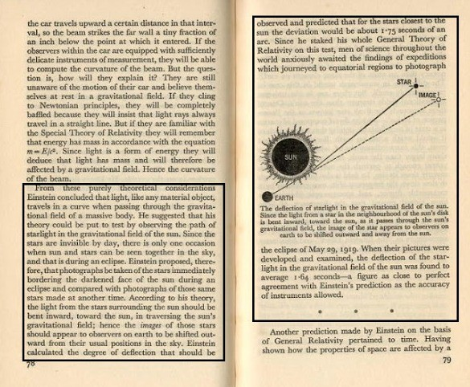
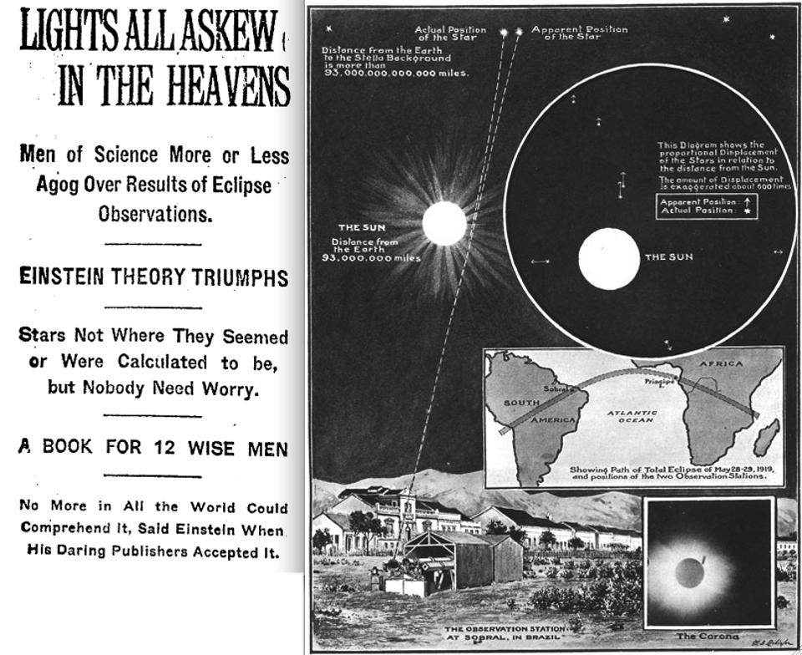
“Science was a series of models continuing to replace each other.”
Tolk, Andreas. “Learning Something Right from Models That Are Wrong: Epistemology of Simulation.” In Concepts and Methodologies for Modeling and Simulation, 87–106. Simulation Foundations, Methods and Applications. Springer, Cham, 2015.
Einstein’s model:
Was more general than Newton’s
Made testable predictions
But Newton’s model remains useful!

Slide 9
The role of modeling in science
“I have been, and remain, entirely committed to the idea that modeling is the essence of science and the habitat of all epistemology.
R. Rosen, Essays on Life Itself, 1500 edition. New York: Columbia University Press, 1999.

Slide 10
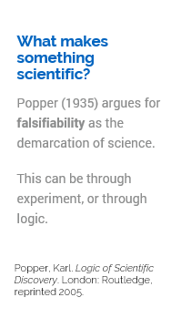
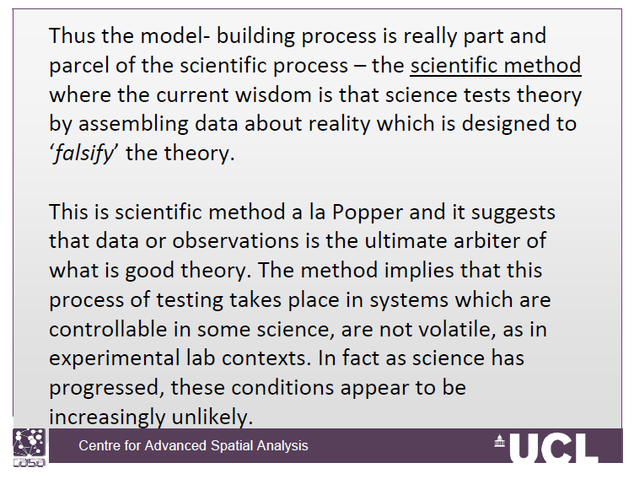
What makes a model scientific?

Slide 11
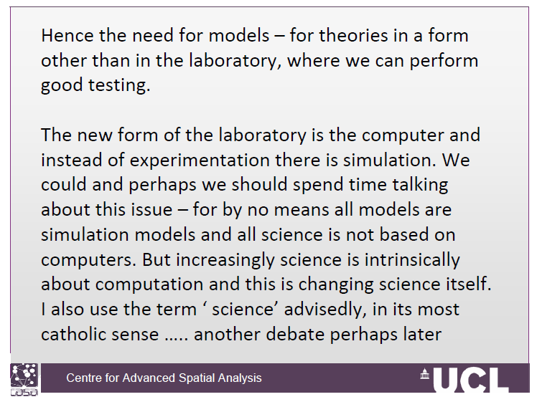
So we test it in the lab, right?
Typically we think of lab experiments as the means of testing theory.
This lets us control for confounding factors.
What if we can’t test it in the lab?
Look at the real world & parse out confounders
Use a model for virtual experiments

Slide 12
A few relevant types of models (not mutually exclusive)
Conceptual models
Mathematical models
Statistical models
Simulation models
Optimization models
Model systems
Agent-based models

Slide 13
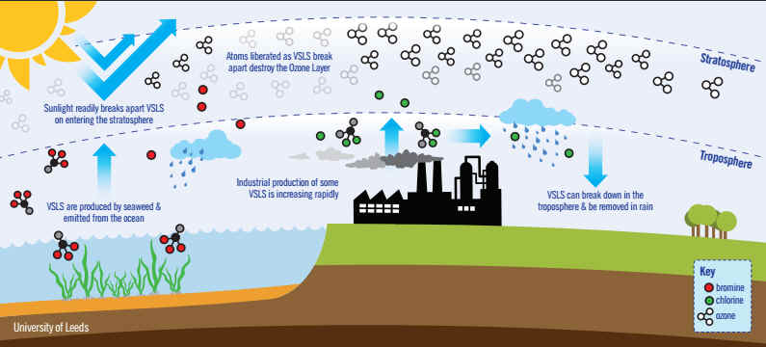
Conceptual Model
Candace Gilet, “Ozone depletion: Uncovering the hidden hazard of hairspray.” University of California Museum of Paleontology. https://undsci.berkeley.edu/article/0_0_0/ozone_depletion_01

Slide 14
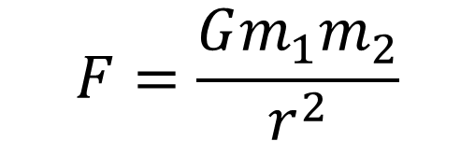
Mathematical Models
$$F=\frac{Gm_{1}m_{2}}{r^{2}}$$

Slide 15
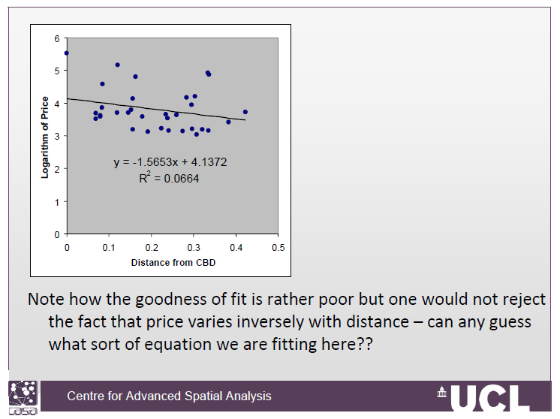
Statistical Models
Descriptive
Or
Predictive

Slide 16
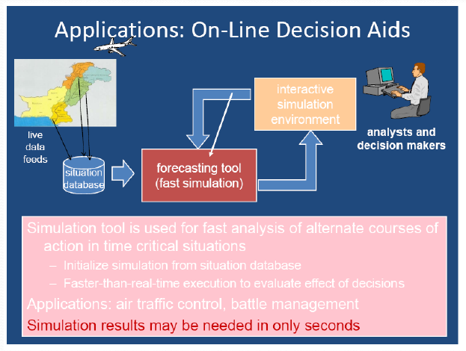
Simulation Models
If I do this, what will happen?
Kahani Kahsmir

Slide 17
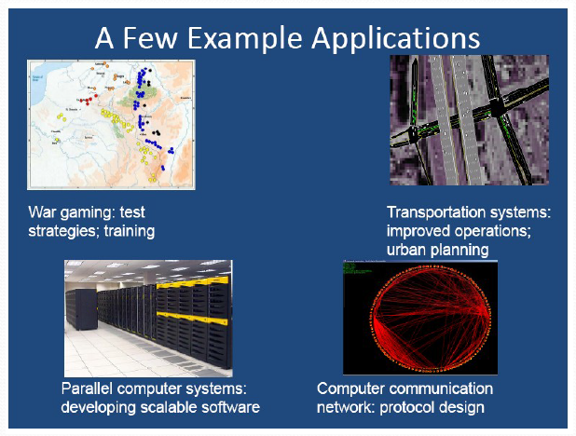
Simulation Models
If I do this, what will happen?
Kahani Kahsmir

Slide 18
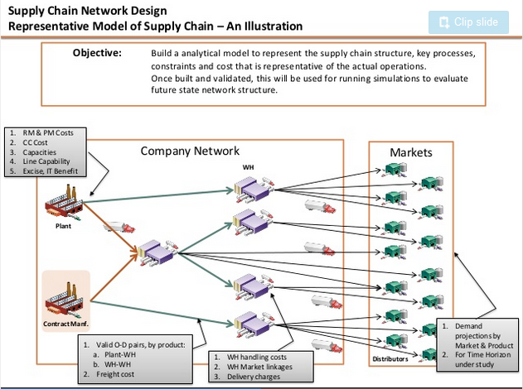
Optimization Models
What should I do?
https://www.slideshare.net/singhmk74/network-optimization-15088394

Slide 19
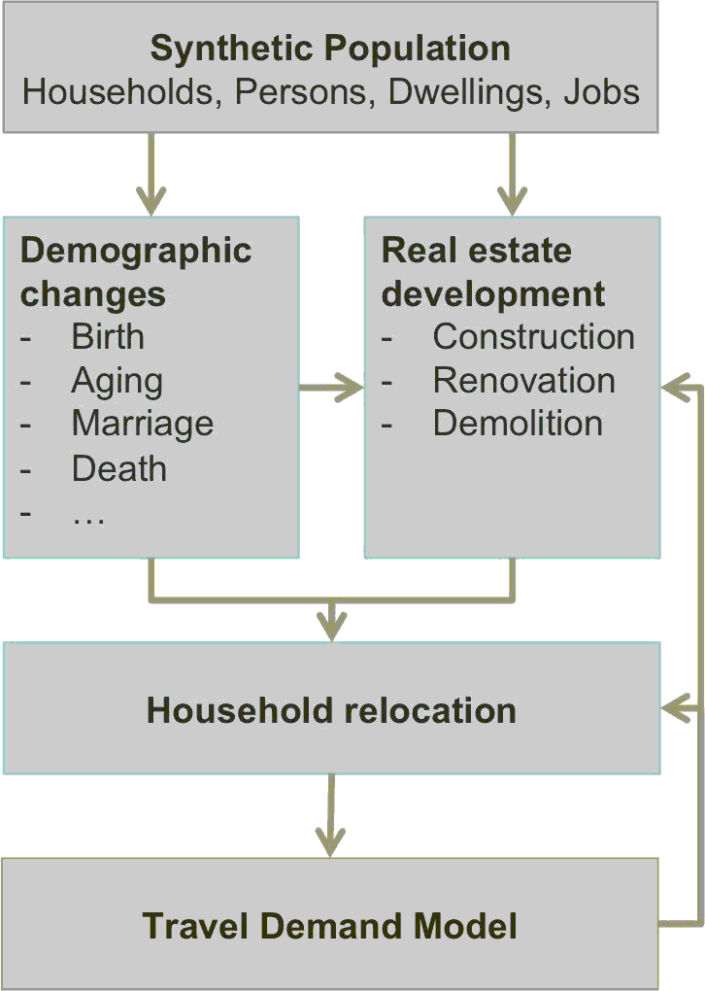
Model Systems
https://silo.zone/introduction.html

Slide 20
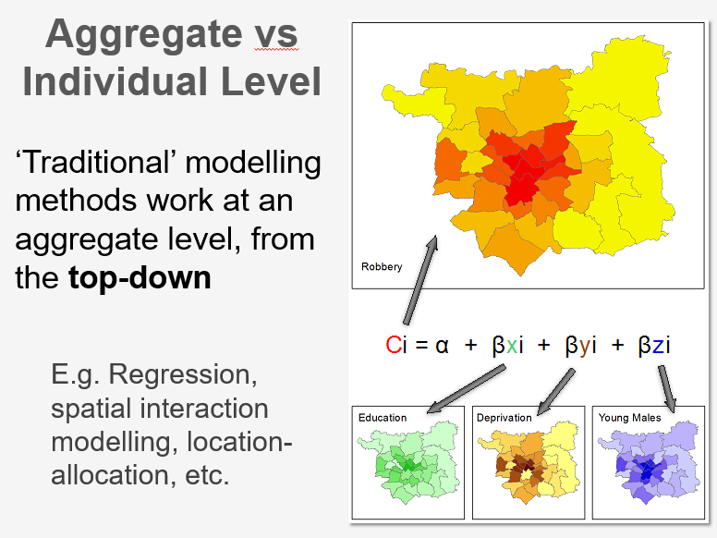

Slide 21
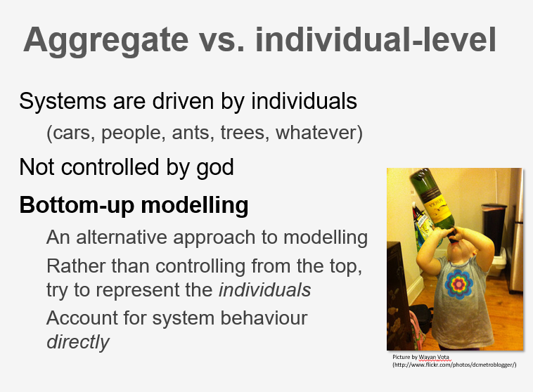

Slide 22
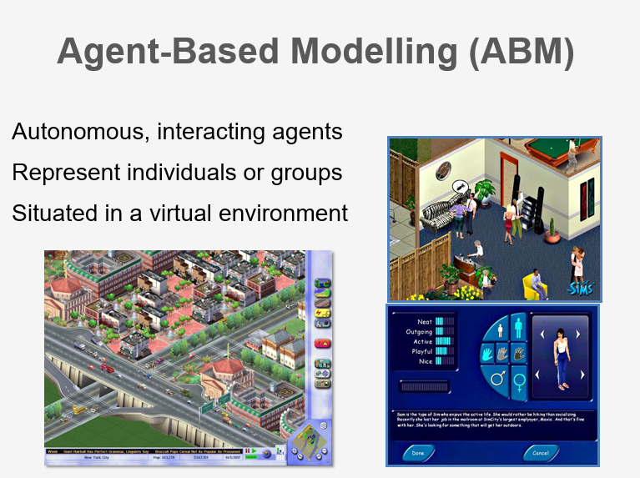

Slide 23
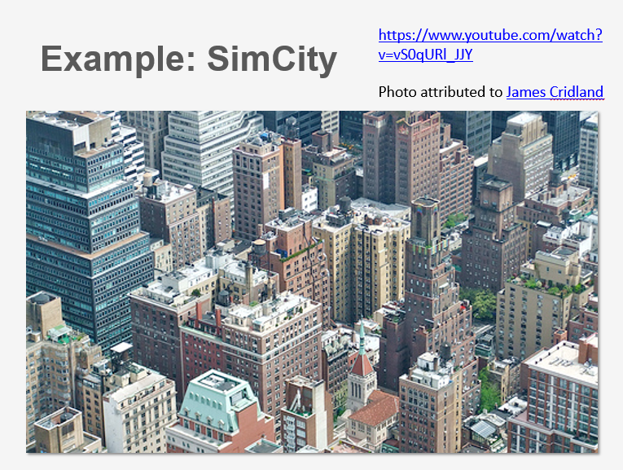
https://www.youtube.com/watch?v=vS0qURl_JJY

Slide 24
Models and Data
Usually we use data to test our models (and our theory).
What happens when our model is derived from data?

